Slide 1

The Pathways Model

Slide 2
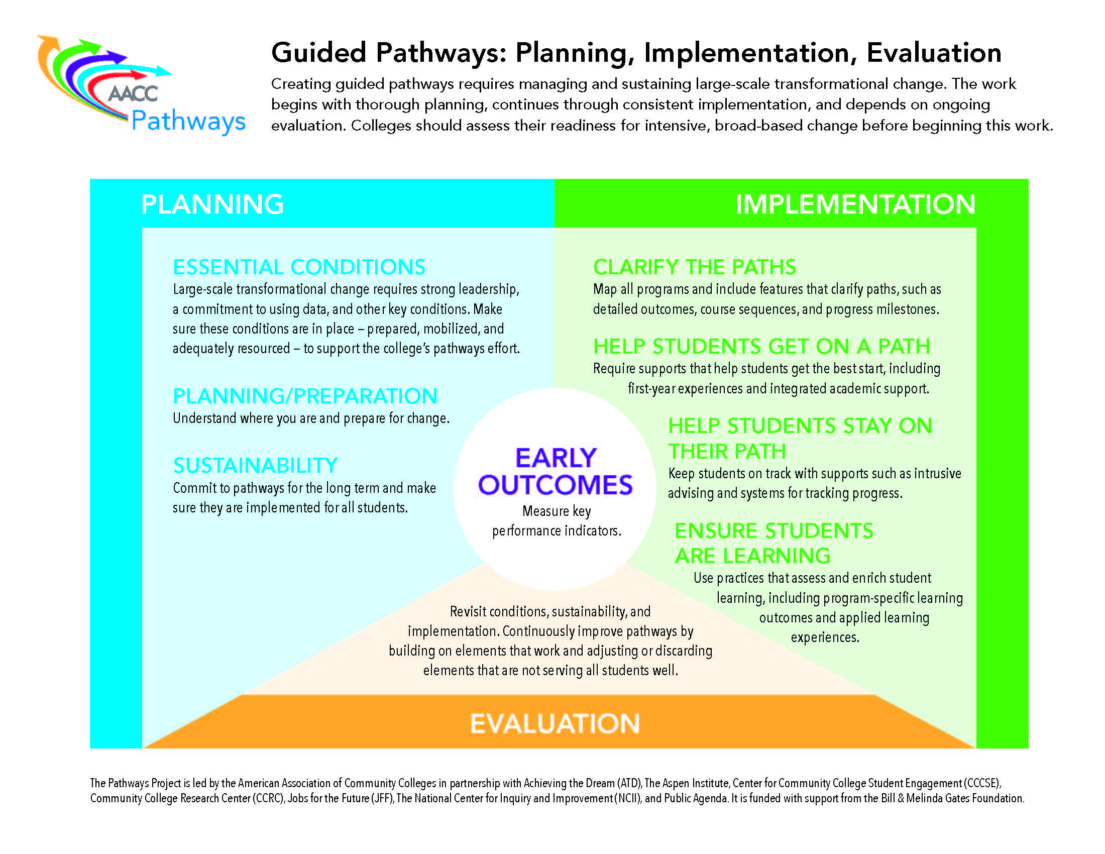

Slide 3
Designing & Implementing
Pathways at Scale
CLARIFY THE PATH
Mapping programs “with the ends in mind”
Aligning course content and student learning outcomes
Identifying milestone courses
Defining default course sequences

Slide 4
Designing & Implementing
Pathways at Scale
CLARIFY THE PATH
Build curriculum coherence
Identify “the right math”
Select recommended core curriculum/ gen ed courses
Select recommended elective courses
Review pathway curriculum for coherence

Slide 5
Designing & Implementing
Pathways at Scale
HELP STUDENTS STAY ON THE PATH
Ensure continuous, intrusive advising within pathways, noting milestone achievement, ensuring timely academic alert and support, and required advising when students go off path.
Integrate discipline-appropriate academic supports into every pathway – and in fact into every syllabus.

Slide 6
Designing & Implementing
Pathways at Scale
ENSURE THAT STUDENTS ARE LEARNING
Intentionally design applied/experiential learning experiences throughout each pathway.
Promote discipline-appropriate strategies for active & collaborative learning (e.g., service learning, group projects).
Align discipline-appropriate co-curricular learning.
Strengthen assessment and documentation of student learning outcomes accruing to the program level.

Slide 7
Designing & Implementing
Pathways at Scale
ESSENTIAL CONDITIONS TO SUPPORT
GUIDED PATHWAYS IMPLEMENTATION AT SCALE
Leadership
Systematic, authentic, continuous engagement
Strategically targeted professional development and technical assistance
Policy to support changes in structures, processes, resource allocation
THE MAJOR CHALLENGE:
CULTURE CHANGE

