Slide 1
The Underground Railroad:
Pathways, Leadership &
the Role of Equity
The Pathways Project
American Association of Community Colleges
February 4, 2017
David Dodson
President, MDC

Slide 2


Slide 3
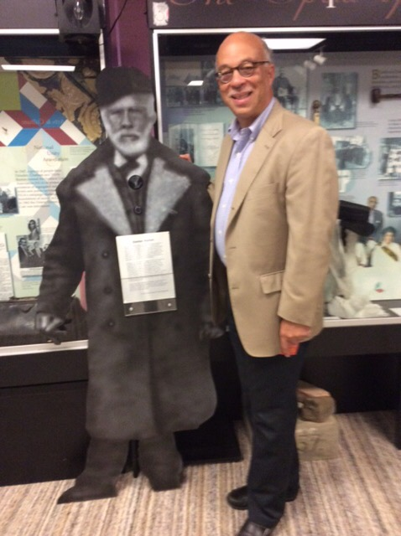
Stanton

Slide 4
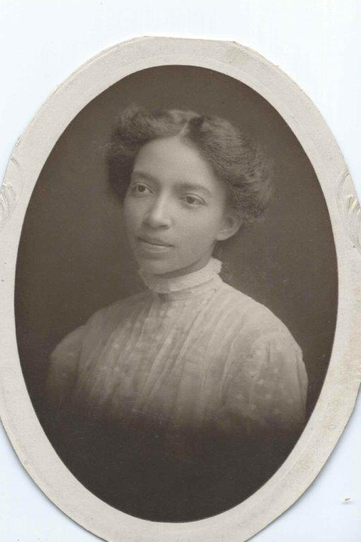

Lillian and Norris

Slide 5
Common factors that advanced mobility for Lillian and Norris
Personal drive
Launching-pad institutions that developed confidence and skill
Family, educators, and mentors with a commitment to equity
An economy that generated opportunity for educated people
Notes:
Culture of aspiration and urgency within family and community
Launching-pad institutions that developed confidence and skill
An economy that generated opportunity for educated people

Slide 6
What factors prevented better odds for Lillian & Norris’s peers?
Lack of commitment to racial justice and equity
A weak Infrastructure of Opportunity
Public policy that made advancement selective—not universal
What factors would you add?

Slide 7
Your Family’s Mobility Story
When was a commitment to equity apparent in the design or execution of the pathway your forbearers travelled?
When was a commitment to equity lacking?
Where did mobility depend on personal heroism without the support of others?

Slide 8
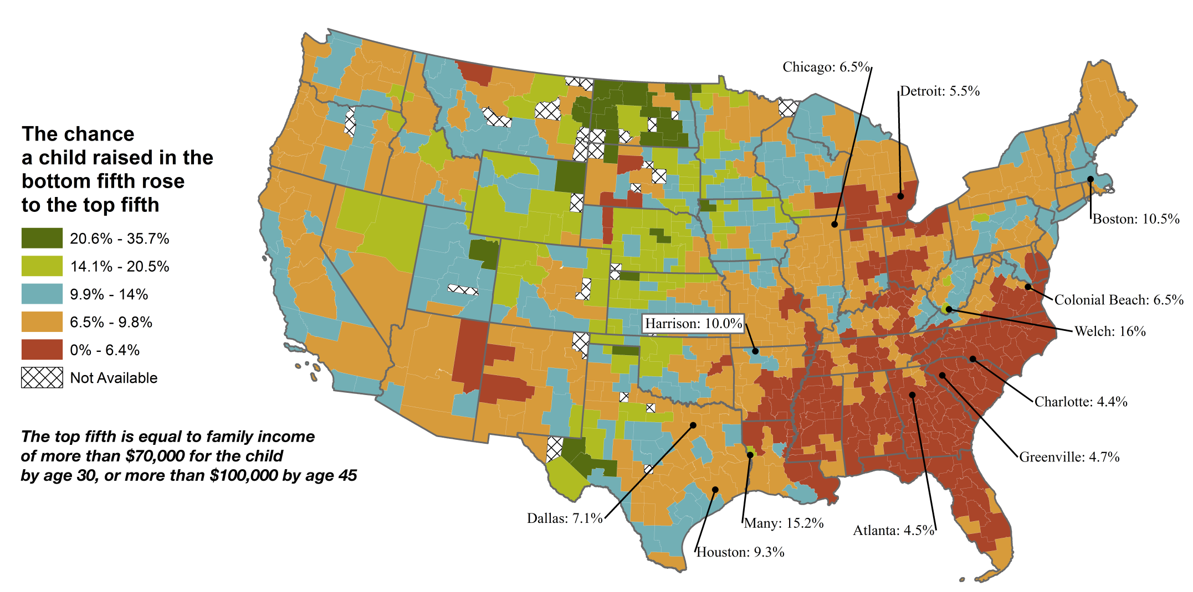
The American Dream is broken
Source: Equality of Opportunity Project
Notes:
Place Matters: national problem with regional peaks and troughs. Charlotte is at 4.4% on this map.

Slide 9
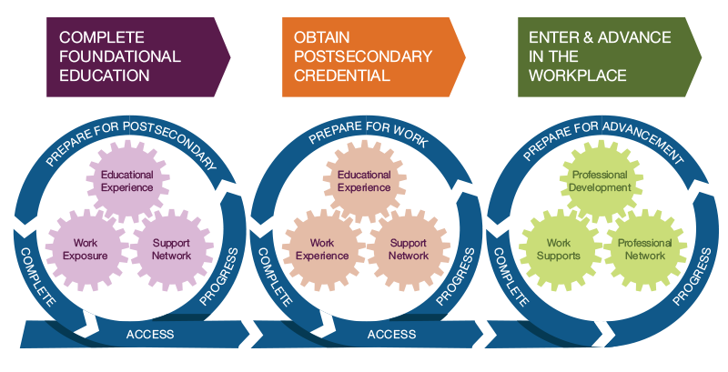
The Infrastructure of Opportunity
Residential Segregation
Income Inequality
Local School Quality
Family Structure
Criminal Justice System
Social Capital
Transportation
Structural Racism
Institutional Policies
Cultural Messages &
Media Representation
Public Policies
Copyright © 2016 MDC
Notes:
Our education system exists not on its own—but in an ecosystem of mobility.
While our focus has been on this work – access to, persistence in, and completion of postsecondary credentials, the path to possibility involves more. There are systemic and cultural barriers in place. It’s not enough for our work to focus internally on our organizations—our work must also address the underlying systems, the community, and the community culture. To change mobility outcomes, we need to work on the systems and culture that keep the current patterns in place.
Note: the factors at the top are systems. Three at the bottom (cultural messages and media representation, social capital, and race and ethnicity) are all social and cultural forces.

Slide 10
Vigilant attention to equity is needed to ensure persistence along guided pathways.
In what aspects of your college’s systems, practice, and culture will attention to equity be particularly necessary as you implement?
What does this mean for your leadership?

Slide 11

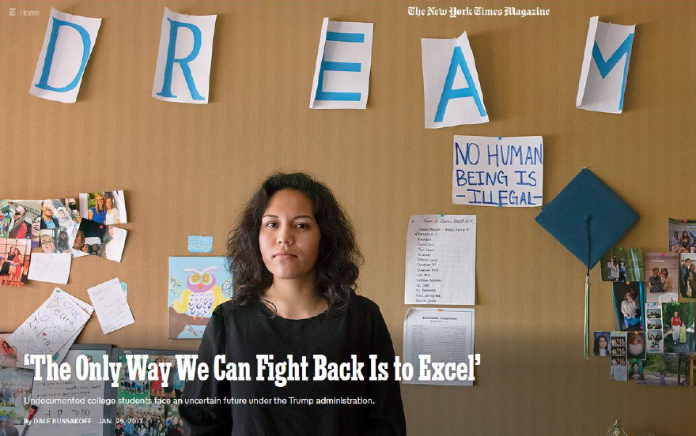
Heroism is not a solution to persistence
Attention to equity in design & execution is

Slide 12
307 West Main Street
Durham, NC 27701-3215
Phone: 919.381.5802
Fax: 919.381.5805
@MDCinc
www.mdcinc.org
www.stateofthesouth.org

