Slide 1
Helping Students Stay on the Path: Implementation Section Pillar #3

Slide 2
Rethinking Student Advising
From: | To:
JIT support for major decisions along the path
Info “dump” at orientation
Scheduling available courses
to suit college schedule
Scheduling courses on the student’s plan to fit their schedule
Full-time vs. part-time
On-plan vs. off-plan
Advising vs. teaching
Advisors teach and faculty advise

Slide 3
Major Decisions Along the Path
CONNECTION
From interest to application
ENTRY
From entry to passing program gatekeeper courses
PROGRESS
From program entry to completion of program requirements
COMPLETION / TRANSITION
From program completion to career advancement and further education
What are my career options?
Which college offers programs in my field of interest?
How much will it cost and how will I pay?
What are my program options?
What are program requirements?
Which program is a good fit?
What will I take?
Will credits transfer?
How much time and money to finish?
What if I change my mind about a major?
Am I making progress?
How do I get related work experience?
What if I want to change majors?
What if I am struggling academically?
How much time and money to complete?
How do I balance my other obligations?
How do I transfer?
How do I get a job in my field of interest?

Slide 4
Approaches to Redesigning Advising
CONNECTION
From interest to application
ENTRY
From entry to passing program gatekeeper courses
PROGRESS
From program entry to completion of program requirements
COMPLETION / TRANSITION
From program completion to career advancement and further education
Jackson College (MI) | Navigators (case managers liaise w/ academic departments, financial aid) Academic Departments & Financial Aid
Lansing CC | Academic Success Coaches (case managers liaise w/ prof. advisors) Professional Advisors (embedded in Career Communities)
San Jacinto CC (TX) | Admissions Advisors (enroll students in 1st semester) | Educational Planners (by career pathway – end of sem. 1 to completion) Mental Health Counselors (personal counseling | Career / Employment Team

Slide 6
IRSC: Checkpoint advising manual
Source: Indian River State College

Slide 7
Source: Indian River State College

Slide 8
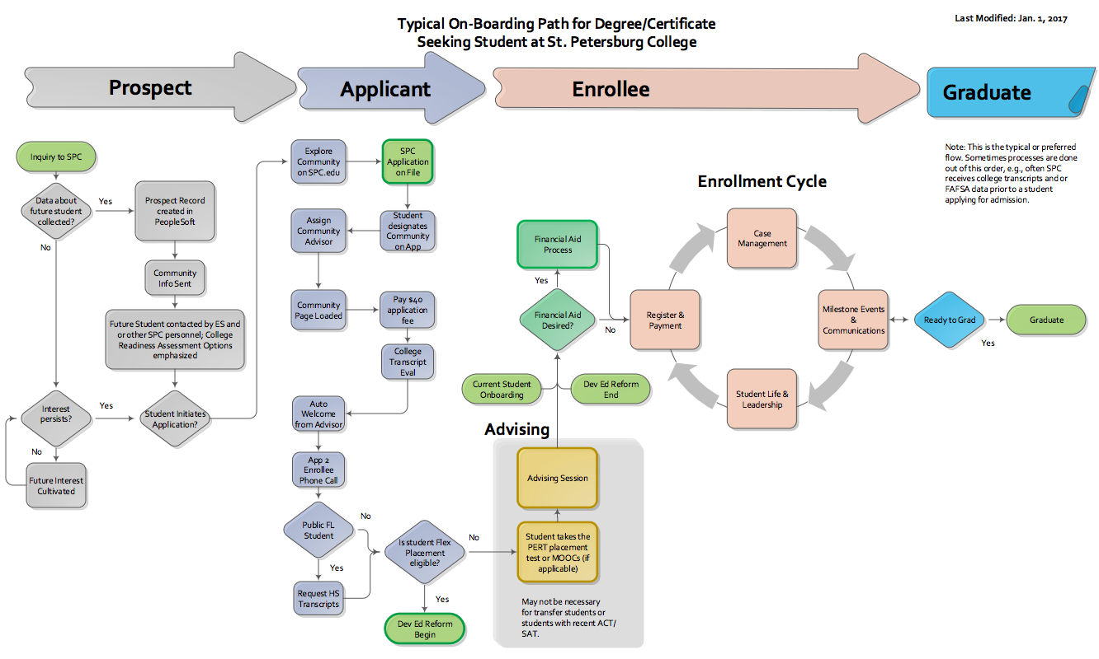
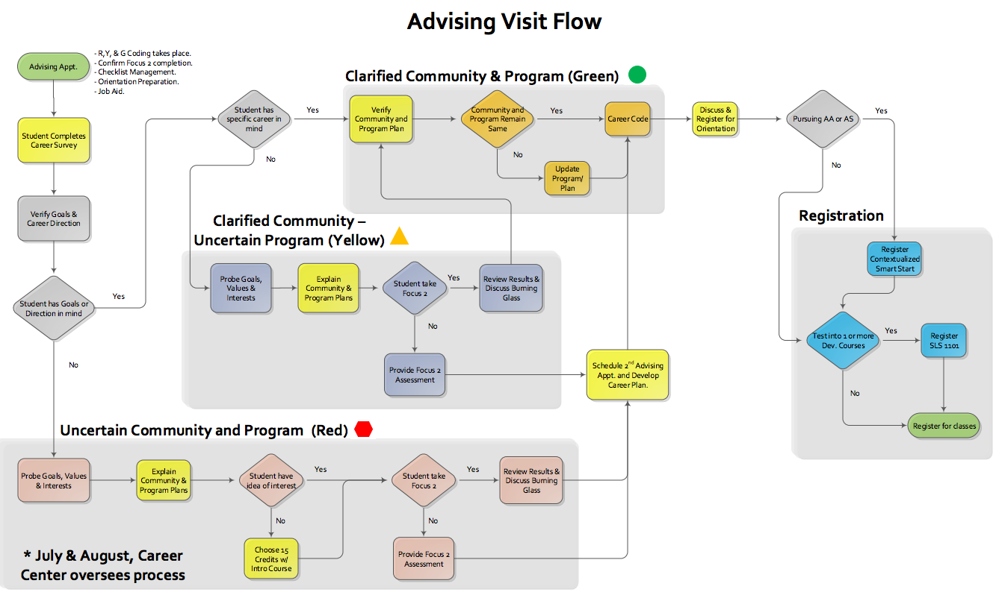

Slide 9
Advising Redesign Key Features
Personal contacts early on, so students feel welcomed and valued
Case management approach, so that every student ideally has one advisor who is overseeing his or her progress throughout
Connection with faculty and others in their field of interest to provide guidance and networking support
Responsibility for guiding students into and through program paths shared by all faculty and staff, regardless of whether they have formal roles as advisors

