Slide 1
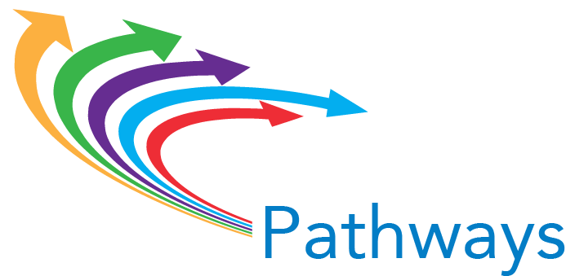
Welcome to Pathways Institute #2

Slide 2
Pathways Design I:
Mapping Pathways
Through the Institution

Slide 3
Designing & Implementing Pathways at Scale
CLARIFY THE PATH
Mapping programs “with the ends in mind”
Aligning course content and student learning outcomes
Identifying milestone courses
Defining default course sequences

Slide 4
Designing & Implementing Pathways at Scale
CLARIFY THE PATH
Build curriculum coherence
Identify “the right math”
Select recommended core curriculum/ gen ed courses
Select recommended elective courses
Review pathway curriculum for coherence

Slide 5
Designing & Implementing Pathways at Scale
HELP STUDENTS CHOOSE AND ENTER A PATH
Strengthen & clarify student-facing information about jobs/careers/ transfer options.
Augment career exploration in high school (especially dual/concurrent enrollment) and earliest college experiences.
Redesign advising to align with critical student choices and milestones.
Embed intrusive advising in pathways.

Slide 6
Designing & Implementing Pathways at Scale
HELP STUDENTS STAY ON THE PATH
Ensure continuous, intrusive advising within pathways, noting milestone achievement, ensuring timely academic alert & support, and required advising when students go off path.
Integrate discipline-appropriate academic supports into every pathway – and in fact into every syllabus.

Slide 7
Designing & Implementing Pathways at Scale
ENSURE THAT STUDENTS ARE LEARNING
Intentionally design applied/experiential learning experiences throughout each pathway.
Promote discipline-appropriate strategies for active & collaborative learning (e.g., service learning, group projects).
Align discipline-appropriate co-curricular learning.
Strengthen assessment & documentation of student learning outcomes

Slide 8
Designing & Implementing Pathways at Scale
ESSENTIAL CAPACITIES TO SUPPORT
GUIDED PATHWAYS IMPLEMENTATION AT SCALE
Leadership
Systematic, authentic, continuous engagement
Strategically targeted professional development and technical assistance
Policy to support changes in structures, processes, resource allocation
IN OTHER WORDS:
CULTURE CHANGE

Slide 9
Institute #2 Objectives
Reinforce the case for implementing pathways at scale; outline strategies for making that case intentionally & effectively throughout the institution.
Review models & processes for organizing programs into meta-majors/ communities of interest.
Build processes & timeline for mapping pathways that include milestone courses, identification of “the right math,” recommended gen ed courses, recommended electives.

Slide 10
Institute #2 Objectives
Develop a program map for at least one program at the institutions, using the mapping framework provided by the Pathways Partners.
Produce draft action plans that delineate next steps in taking pathways reforms to scale, specifically incorporating strategies for (1) broad campus engagement and (2) needs for professional development and technical assistance.

Slide 11
Institute Norms
Start on time, end on time
This is not a “conference;” everyone’s presence is needed. (It’s also not a staff meeting!)
All voices are valued and heard
As a matter of simple courtesy to speakers and other participants, PLEASE use electronic devices only for on-task Institute activities.

Slide 12
Institute Norms
Meet every college where it is in the work of guided pathways reform.
Discussions/ debates are disciplined by data and evidence.
Evaluations are important and used; PLEASE complete them.
Students are the focus: the question is not “Are students college-ready?” but “Are colleges student-ready?”

Slide 13
Lessons and Outcomes from a Scaled Pathways Implementation

