Slide 1
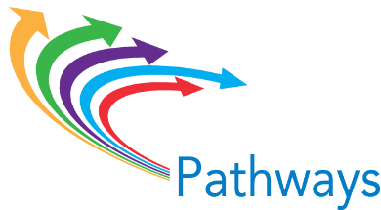
Aligning Guided Pathways with Integrated Advising and Student Supports
Dr. Karen Stout, President/CEO, Achieving the Dream
Mei-Yen Ireland, Associate Director of Integrated Advising and Student Supports
@drkastout
@MeiYenIreland
Pathways Institute #3: October 2, 2016
Notes:
Karen to open, welcome, set context

Slide 2
Outline for Session
What is Integrated Advising and Student Supports?
Transformative Change
Institutional Approaches to Integrated Advising and Student Supports
Critical Elements and Common Challenges
Alignment of Key Components of Integrated Advising and Student Supports and Guided Pathways
Table Discussions
Questions, Comments, and Discussion
Notes:
Karen
Overview session and objectives

Slide 3
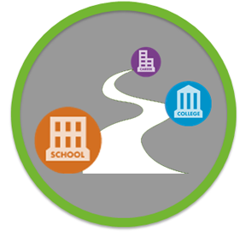
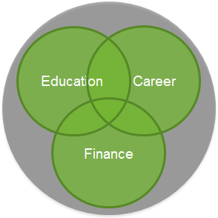
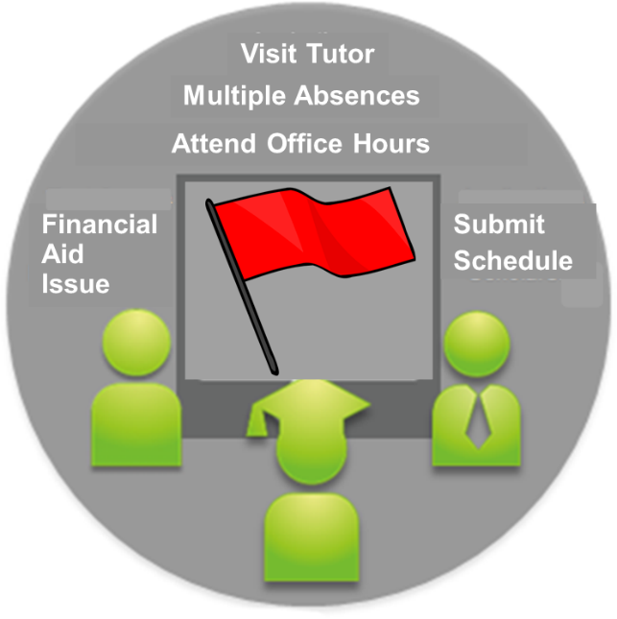
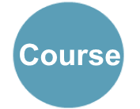
Integrated Advising and Student Supports
+
+
Course
Education and Career Planning
Coaching, Advising, & Counseling
Early Alerts & Intervention Targeting
Notes:
Mei-Yen
Leveraging technology to enhance and streamline systems and services with the goal of transformative institutional change.
Education and career planning
Counseling and coaching
Targeting risk and intervention
Transfer articulation

Slide 4
Why Integrated Advising and Student Supports?
The ability to spur transformative change, rather than merely promote efficiency.
Notes:
Mei-Yen
Why Integrated Advising and Student Supports?
using technology to promote, support, and sustain long-term intrusive and holistic advising relationships

Slide 5
Transformative Change
Structures
Attitudes
Processes
Notes:
Mei-Yen
From CCRC’s research: Transformative change requires organizational growth and development that combines structural, process, and attitudinal change.
Structural changes lay the framework for new behaviors, thereby encouraging improved student experiences throughout the institution.
Process change reforms how people do their jobs at an individual level: it therefore requires supportive structures to ensure it occurs among enough college personnel to change experiences for large numbers of students.
Transformative change takes root when attitudinal change occurs—when individuals start to understand their work and view work processes in new ways.
EXAMPLE→
Structural change: Clarify degree pathway map (Guided Pathways) and implement degree planning tool to support advisors to work with students in a more coaching/proactive advising approach (iPASS).
Process change: Embedded, proactive advising and progress tracking is the system for student supports (Guided Pathways and iPASS)
Attitudinal change: Student support through Guided Pathways and iPASS is an institutional priority with broad ownership

Slide 6
Integrated Advising and Student Support: Using the SSIP Approach
Sustained
Ongoing support rather than an “inoculation” approach.
Strategic
Differentiated services to maximize capacity.
Intrusive and integrated
Services are an integral part of all students’ experiences, and are not viewed as stand-alone interventions.
Personalized
Students receive the support they need when they need it, from an individual who knows them well.
Karp, M.M., & Stacey, G.W. (2013). What we know about nonacademic student supports. Research Oveview. New York, NY: Community College Research Center, Teachers College, Columbia University.
Notes:
Mei-Yen
Using technology enables personnel throughout the college to engage in advising and student support relationships that:
Advising is viewed and delivered as a form of teaching (Appleby, 2008), meaning that it is delivered in a way that builds students’ problem-solving and metacognitive skills over time; and
Student supports take a “SSIP” approach (Karp & Stacey, 2013), meaning that advising and student support is provided in a way that is sustained, structured, intrusive, and personalized. iPASS technologies enable these practices by informing, streamlining, and integrating student support activities, thereby enabling structures and processes that support advising-as-teaching and SSIP.
3) connect them to the information and services they need when they need them, in order to keep students on track to graduation.

Slide 7
Institutional view: What does it look like to pursue integrated advising and student supports?
Notes:
Karen
Share Montgomery story of IPAS1 to provide an example of what it looks like on the ground.
Then transition to back to Mei-Yen to share critical challenges and elements.

Slide 8
Lessons Thus Far: Critical Challenges and Elements
Notes:
Mei-Yen share common challenges and critical elements of effective integrated advising and student supports

Slide 9
Engagement & Communication
Effective communication of project vision to all stakeholders
Initiative fatigue and time/resource constraints
End-user adoption of technology/behavioral change
Effective training models for faculty and students
Data & Technology
Integrating multiple student success technologies
Identifying most valuable data (lead and lag) to track for various stakeholders
Building and maintaining effective relationship with multiple vendors
Advising Policies & Practices
Effective advising models tailored for various students, for example for dev ed students or STEM students
Starfish flag management
Scaling the work
Strategy & Planning
Alignment with other student success work
Efficient and effective change management
How to maximize resource efficiency to help build sustainability
Notes:
Mei-Yen
These are common challenges we have identified across the 15 institutions we are working within the integrated advising initiative:
- Engagement and Communication
Requires multiple stakeholders, lesson learned from IPAS1
Transformative, institutional change requires effective communication of vision to generate buy-in
Data & Technology
Challenges of integration
Role of data
Upcoming webinar on tech vendor engagement
Advising Policies and Practices
Harder than tech implementation—need strong vision from the beginning
Strategy and Planning
Aligning with other student success work (connect to Zane’s experience)

Slide 10
Critical Elements
Communicating the vision to all stakeholders to generate buy-in
Connecting integrated planning and advising to other student success efforts
Placing advisors and faculty in key leadership roles
Strengthening collaboration across silos
Assessing readiness and engaging in honest cross-hierarchical and cross-functional conversations early
Notes:
Mei-Yen
This spring we facilitated Kotter Change Essentials (change leadership) trainings with 15 iPASS institutions. As these institutions were engaging with the planning work and preparing to launch their revised system, these are some of the critical elements that institutions identified as being crucial for their success:
Importance of Communication & Engagement and Leadership & Vision
challenge of communicating messages broadly and across different stakeholder groups
Importance of clear, broad, and transparent communication for transformative institutional change. In particular, the need for a clear vision. I often heard institutions questioning….
How do we co-construct and communicate a shared vision of this transformation broadly?
How can we connect the purpose of iPASS to the larger institutional mission and student success agenda so that everyone is on the same page about the purpose and benefit?
How can we get above the “noise” and multitude of informative emails that staff and faculty receive?
Who needs to be at the table in order to ensure that the message and method of communication accounts for diverse stakeholders?
Pause for questions about what is integrated advising and student supports before transitioning to Karen to do a deeper dive into the alignment of integrated advising and guided pathways…

Slide 11
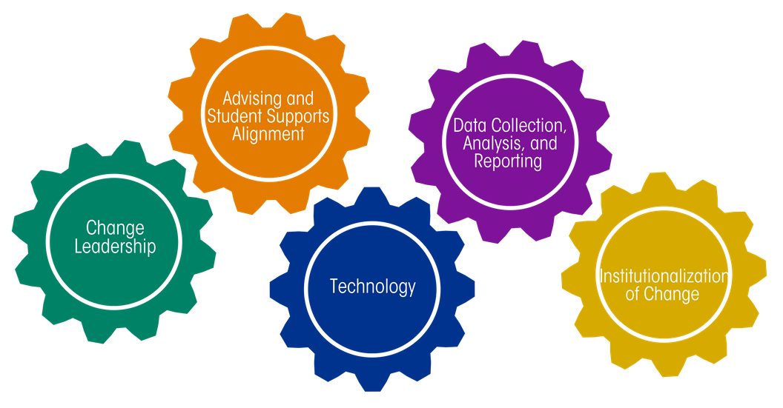
Readiness Assessment
Notes:
Mei-Yen
Early assessment of readiness emerged from the key elements and challenges that we have identified from institutions pursuing integrated advising and student supports.
Let’s look a little closer at the readiness assessment you completed as pre-work…
Walk through main components (change leadership, advising and student support alignment, technology, data collection, and institutionalization of change)
Ask for show of hand as to which component was least prepared
Close with comment about how they are likely already seeing alignment of readiness principles between Pathways and integrated advising and student supports (mention example)
Transition to Karen to go into more depth about the alignment of the principles…
Change Leadership (communication, structure, vision)
Advising & Student Supports Alignment (approach to advising, integration of student supports, technology use)
Technology (IT System Capacity, IT Adoption, IT Compatibility)
Data Collection, Analysis, and Reporting (Data Collection Capacity, Data Analysis and Reporting, Culture of Data Use)
Institutionalization of Change (Behaviors and Attitudes, Planning and Strategy, Ongoing Resources and Support)

Slide 12
Aligned Redesign Approach
Guided Pathways | Integrated Advising and Student Supports
Redesign the entire student experience | Support students through their entire experience from connection to the college through to transfer to a four-year institution or career.
Unify multiple student success initiatives | Integrate the myriad student support services and technologies that support students through degree and career planning, risk targeting and intervention, counseling and coaching, and transfer and articulation.
Begin with the students’ end goals in mind | Use technologies and services support students as they connect with the institution to learn about their education and career goals and support students to stay on the path to their goals.
Notes:
Karen
Both are redesign approaches focusing on the entire student experience
After clarifying program maps, it takes a lot of internal management to make systems intuitive and build out the connective power of the pathway. Requires unifying technologies and initiatives.
Focused on student education and career goals

Slide 13
How do we answer these student questions?
What if I need an early intervention?
How do faculty and staff communicate to ensure my success?
Am I on track to graduate?
What will I need to take next term?
How can I get help?
What is my path?
What are my career options?
What if I want to change programs?
What if I run into trouble?
What knowledge have I gained and how does it prepare me for further education or the workforce?
What will I need to take?
Notes:
Karen

Slide 14
Aligned Principles
Clarify paths to student end goals: Degree maps; transfer articulation
Help students choose and enter a path: Coaching and Advising; Diagnostics
Montgomery County Community College: All students will have a career, financial, and academic plan
Northeast Wisconsin Technical College: Integrated advising model between faculty mentors and academic advisors
Community College of Philadelphia: Enhance degree audit utilization and use early alert to move to a case management approach
Help students stay on a path:
Early Alert & Tracking; Degree Audit; Coaching
Aligning academic supports with program outcomes; Moving to developmental advising interactions
Ensure students are learning: Tutoring; Analytics; Redesign Advising Interaction
Notes:
Karen
Clarify the path means, for iPASS, building strong degree plans and transfer maps to answer the question “What will I need to take?”
EXAMPLE: Montgomery County is implementing financial and career planning in their iPASS work in order to move to the eventual goal of all students having a career, financial, and academic plan—this work requires that paths are clarified and well-defined.
Helping students get on a path, means for iPASS, redesigning coaching and advising and using technology to support the development of a stronger analytics culture for real-time diagnosis to answer the questions: “What if I want to change programs?” and “What if I get in trouble?”
EXAMPLE: Northeast Wisconsin Technical College is developing an integrated advising model between faculty mentors and academic advisors that will use academic planning, early alert and new intake survey/predictive analytics works to enhance advising and help make connections with students more engaging and informed.
Keeping students on a path, for iPASS means, designing early alert and progress mapping, degree audits that are student facing, and continued coaching to answer student questions like: “Am I on track to graduate?”
EXAMPLE: Community College of Philadelphia is enhancing their utilization of DegreeWorks audit to support their Guided Pathways work and utilizing early alert communication tools for advisors, support staff, students, and faculty to promote a more case management approach to communication and connecting students to supports.
Ensuring Learning, for iPASS means, ensuring that academic supports like tutoring are designed to support program outcomes and to answer student questions about the knowledge they are gaining that leads to employment or transfer.
EXAMPLE: Enhancing the advising relationship to move from prescriptive advising to developmental advising (or advising as teaching). Several institutions in the Randomized Control Trial sub-group of iPASS grantees are looking at how to develop guiding questions for advisors that address cognitive development (e.g., help students make meaning of their courses in relation to their degree and career plan and to think about how their current courses prepare them for their careers).
Guided Pathways = white puzzle pieces
Integrated Advising and Student Supports= yellow

Slide 15
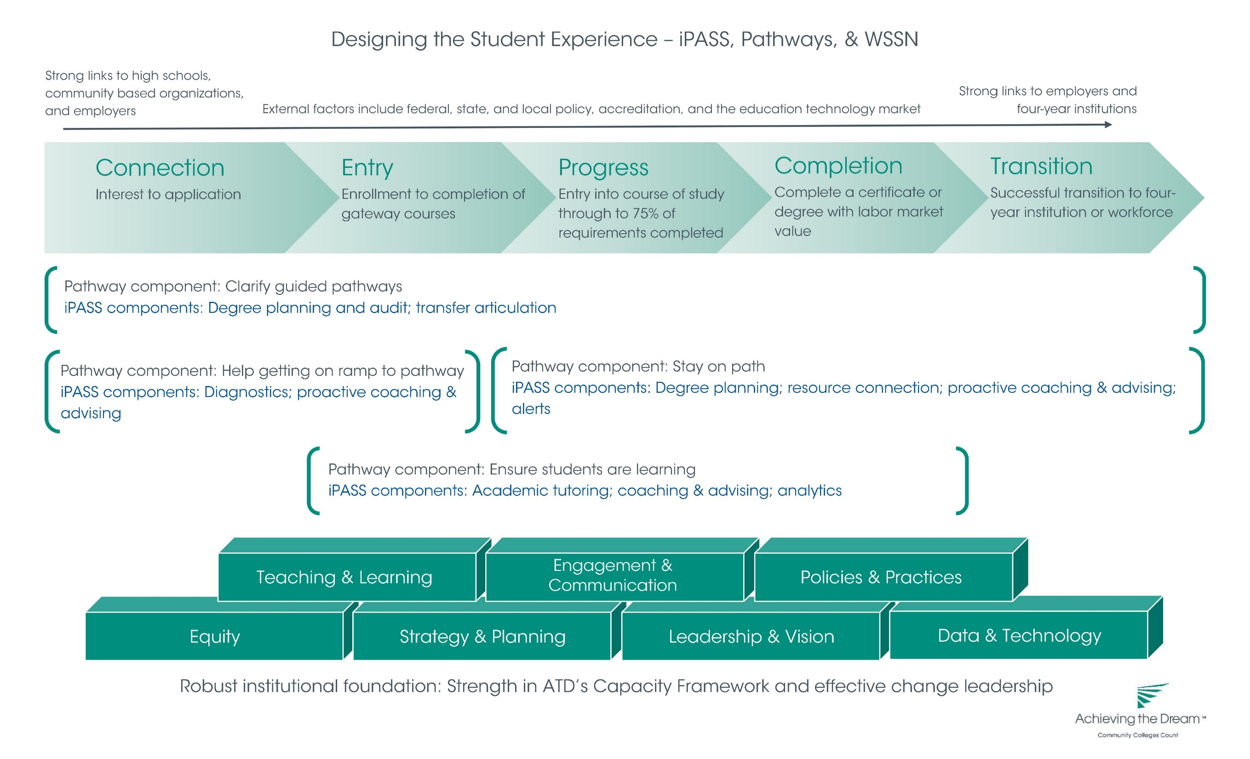
Notes:
Karen
Summary—another way to summarize what we showed you
Key is that this is about change leadership…transition to transformative change framework

Slide 16
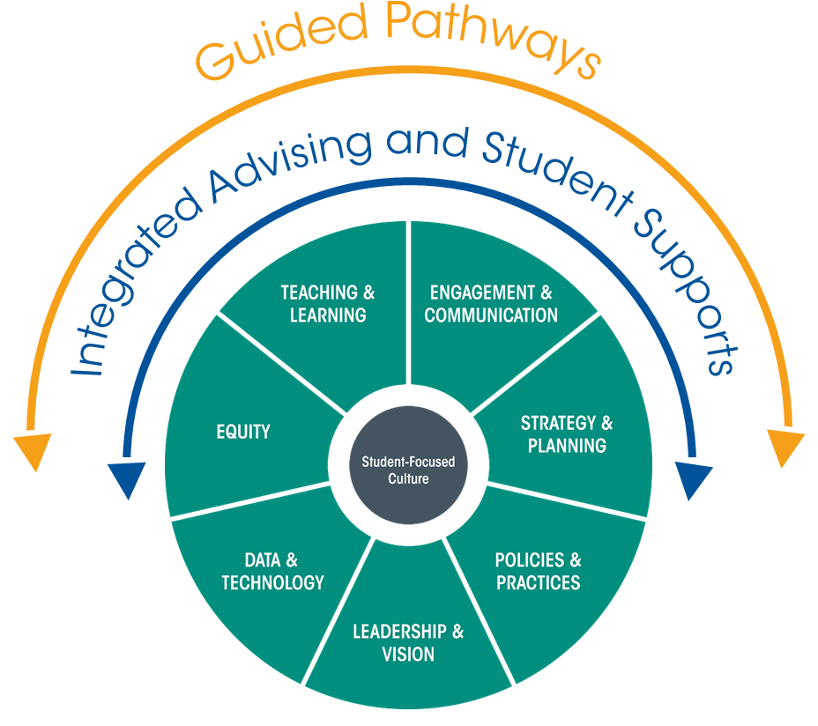
Institutional Capacities for Transformative Change
Notes:
Karen
This is hard work—we’ve worked with many colleges and even those on the leading edge are not actually doing Guided Pathways and iPASS in the way the principles describe them.
Capacities needed to position an institution to do Guided Pathways and iPASS (transformative change)
Strength in seven capacities is key to iPASS and Guided Pathways success, particularly….(pick 2-3 to highlight)
Engagement & Communication: iPASS and Guided Pathways require broad engagement and buy-in from stakeholders across the institution. As grantees of iPASS, you all know from your Kotter Change Leadership training that communicating to build urgency is critical for success.
Leadership & Vision: iPASS and Guided Pathways are transformative institutional change efforts and strong leadership (leadership that is cross-hierarchical and cross-functional) as well as having a vision that is aligned across all levels of the organization is crucial.
Teaching & Learning: Developing clear roadmaps requires difficult and intentional conversations within departments and clear expectations so that when students are creating their degree maps (a part of iPASS) the maps can be a powerful tool for students.
Data & Technology: Can you do Guided Pathways without iPASS or vice versa? Both require strong data & technology to be successful.
Equity: This is one of the most crucial capacities for iPASS and Guided Pathways and it is mostly likely to be overlooked. As we redesign the student experience, are we assuming a one-size fits all approach to a students’ progression through the pathway? How are we incorporating equity-minded practices in the development of Guided Pathways and iPASS? This is particularly illuminated with the increasing focus on predictive analytics in iPASS.
Strategy & Planning: Pursuing iPASS and Guided Pathways is a long-term process, cannot be completed in one academic year. Strong institutional capacity in strategy & planning will ensure the transformative change takes roots and has the desired impact.
Policies & Practices: As CCRC’s definition suggests, transformative change requires institutionalization of new policies and practices within the culture of the organization. iPASS and Guided Pathways are more than boutique interventions but need new policies and practices for real adoption to take place.

Slide 17
Questions to Consider
For those actively pursuing both Integrated Advising and Guided Pathways:
For those actively pursuing Guided Pathways and heading towards Integrated Advising:
What structures or processes have you put in place to ensure they are being pursued as a cohesive transformative change strategy rather than as isolated initiatives?
What specific changes are you producing through each effort that address all levels of transformative change (structural, process, and behavioral)?
Consider mapping the ways in which Integrated Advising and Student Supports will support your Guided Pathways reform.
What momentum from Guided Pathways (urgency and buy-in) can you leverage to pursue Integrated Advising?
What vision do you have for the student experience and how can Integrated Advising and Guided Pathways get you there?
Notes:
Karen
To what extent are your efforts adhering to the principles and approach we discussed today?
Emphasize that these are both long-term processes – not over one year or even one grant cycle

Slide 18
Individual Reflection
Using the blank “Aligned Principles” handout, what are your current and desired advising and student support structures that can support your Guided Pathways implementation?
What do your readiness assessment results say about possible challenges in pursuing your desired integrated advising and student support approach?
Notes:
Karen
5-10 minutes for individual reflection

Slide 19
Table Discussions
How does an integrated advising approach support Guided Pathways implementation?
What key readiness areas do you need to address and what next steps would you need to take to move your institution higher on the readiness continuum?
What other initiatives and stakeholders need to be connected in order to align integrated advising and student supports with your Guided Pathways work?
Notes:
Karen
15 minutes for table discussions

Slide 20
Questions and Comments?
Notes:
Karen (5-10 min)
Facilitate questions and comments based on the table discussions as well as general questions
Provide closing thoughts

Slide 21
Learn More about Integrated Advising and Student Supports
Overview of the Integrated Advising and Student Supports approach
www.achievingthedream.org/ipass
Dr. Stout’s lessons learned on communicating your student success vision
http://er.educause.edu/blogs/2016/3/reflections-on-communicating-a-vision-for-ipass-reforms
Dr. Ireland’s reflections from providing change leadership training to grantee institutions
http://er.educause.edu/blogs/2016/7/the-challenges-and-opportunities-of-ipass-reform
Research on the successful implementation of integrated advising and student supports approach at community college
http://ccrc.tc.columbia.edu/research-project/integrated-planning-and-advising-services.html

