Slide 1
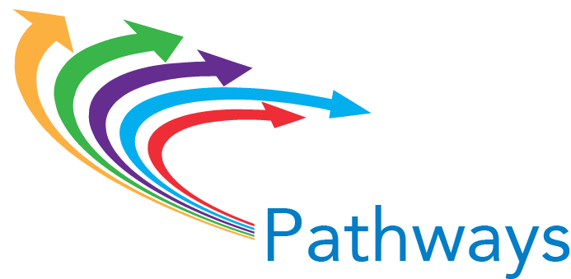
Helping Students Get on the Path: Implementation Section Pillar #2

Slide 2
Rethinking Student On-boarding
From: | To:
Job/transfer support for near completers
Career/college exploration and planning for all from the start
Current semester schedule
Full-program plan
Academic assessment
Holistic assessment
Pre-requisite remediation
Co-requisite academic support
Algebra and English comp
Critical program courses
Exploration of program pathways beginning in HS
A lá carte dual HS credit

Slide 4
Jackson College Student Planning
Using JetSTREAM to customize plan

Slide 5
What makes for a good plan?
Covers entire program based on default program maps
Customized for each student to account for:
prior credits (dual enrollment, transfer, AP, etc.)
educational goals and personal interests
transfer destination and major
timeline to completion
Contains at least 1 program course in first term, and 3 program courses in first year
Easily accessible by student, advisor, faculty
Tied to scheduling/registration process and locked into student information system

Slide 6
The New Student Experience
Notes:
The new student experience at Valencia
Students…
* attend a required new student orientation where they receive
assistance in identifying a major area of study
* advice on course choices
Take the required NSE Course in which they
* explore and articulate their educational/career purpose and goals
* learn and apply college success skills
* demonstrate effective communication skills
* create an individualized education plan (MEP)
* connect with an assigned advisor
* attend co-curricular activities that support the foundation of the NSE
Complete a specified number of workshops, activities, and events to earn a College Certificate
Complete the Start Right Courses in their program of study

Slide 7
The New Student Experience
Extended Orientation to College
Starting a habit that will continue
Start Right

Slide 8
The 6Ps
The New Student Experience Student Learning Outcomes
Purpose: Students will create a personal purpose statement that outlines and articulates their values, goals, interests, and strengths in relation to their educational and career aspirations.
Pathway: Students will choose an academic program aligned with their educational/career goals, interests, strengths, and values.
Plan: Students will design an education plan that include goals for learning and a financial plan.
Preparation: Students will apply college success skills.
Personal Connection: Students will demonstrate effective communication skills with diverse groups.
Place: Students will demonstrate awareness of college support systems.
Notes:
Kurt, Jamy, John

Slide 9
All of the AACC Pathways colleges are experimenting with new and promising approaches to developmental education…
…but with a couple of notable exceptions, they have not yet connected these efforts to their guided pathways reforms at scale.
Examples:
Cleveland State Community College (TN)
Stanly Community College (NC)
Wallace State Community College (AL)

Slide 10
Early evidence of impacts

Slide 11
AACC colleges are beginning to build pathways down into high schools, starting with dual enrollment students
Examples:
Indian River State College (FL)
“Great Explorations”
Required SLS 1000
Build an academic plan
Columbus State Community College (OH)
College Credit Plus
Pierce College (WA)
Career cruising
Washington Career Pathways

