Slide 1
Clarify the Paths: Implementation Section Pillar #1

Slide 2
Rethinking Mapping Programs
From: | To:
Academic / career communities (“meta-majors”)
Alphabetical program list
Program maps with course sequences, critical courses, co-curricular requirements
A lá carte courses (distribution requirements and electives)
Algebra as default math path
Program/field-specific math paths
Degree pathways with embedded certificates/certifications
Certificates vs. degrees
Connections to careers &
transfer unclear
Career & transfer opportunities/ requirements clearly specified

Slide 3
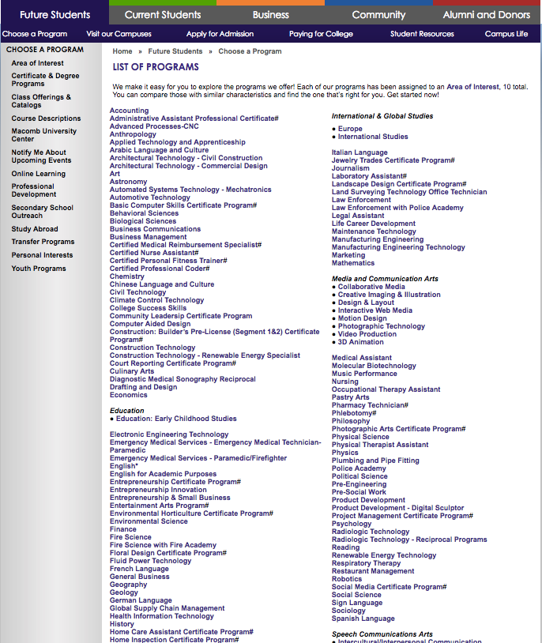

Slide 4
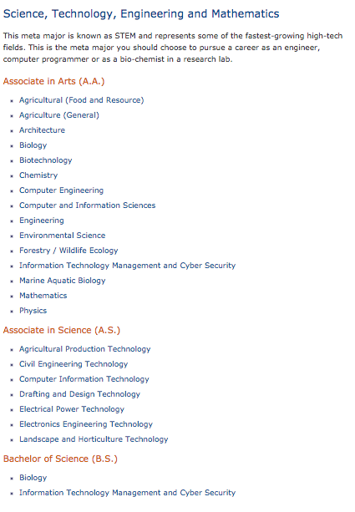
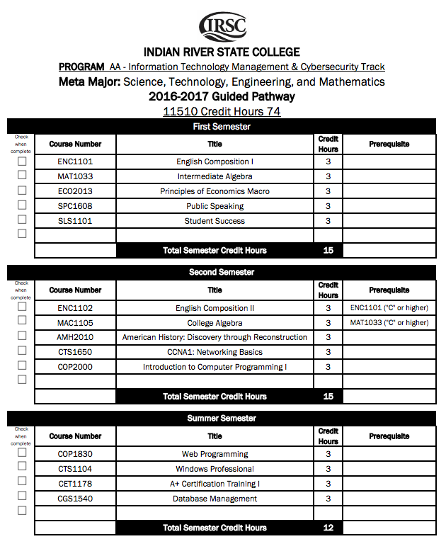
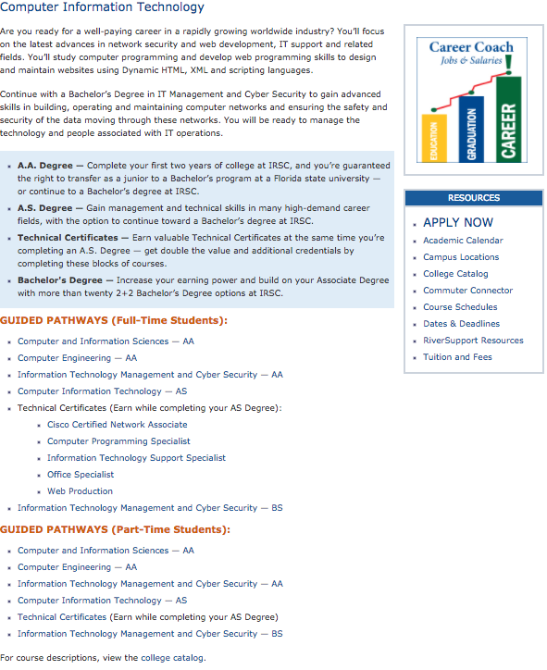
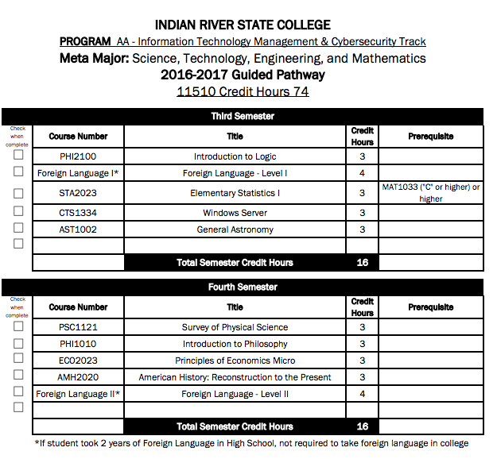

Slide 5
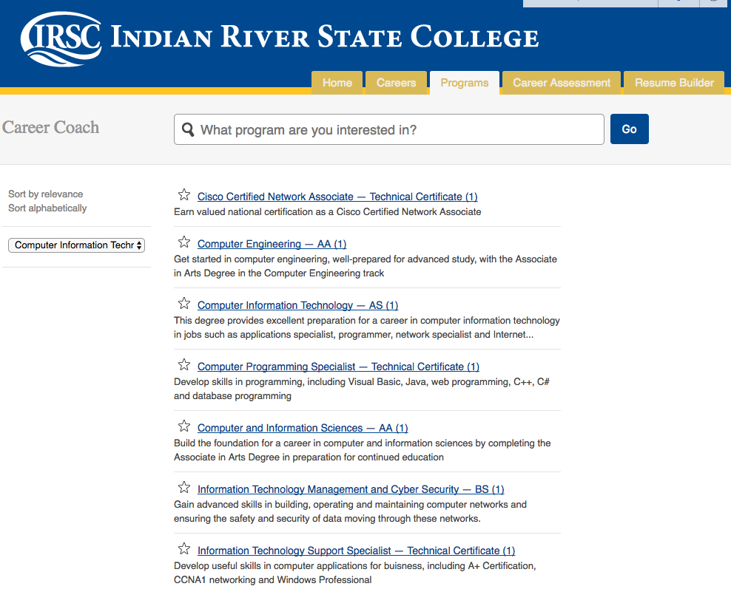
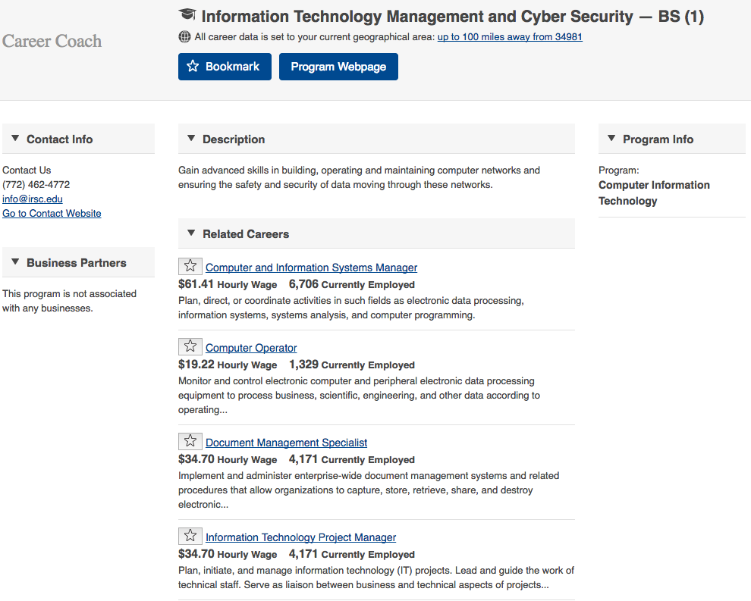

Slide 6
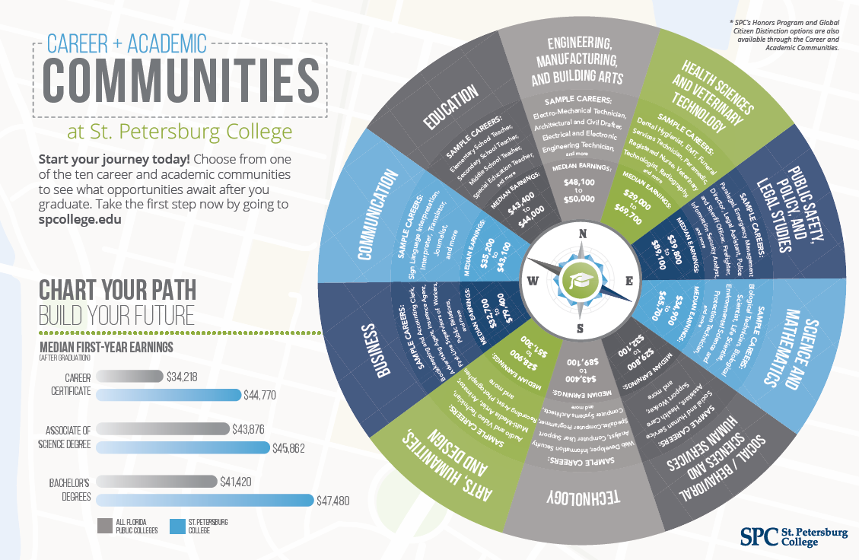

Slide 8
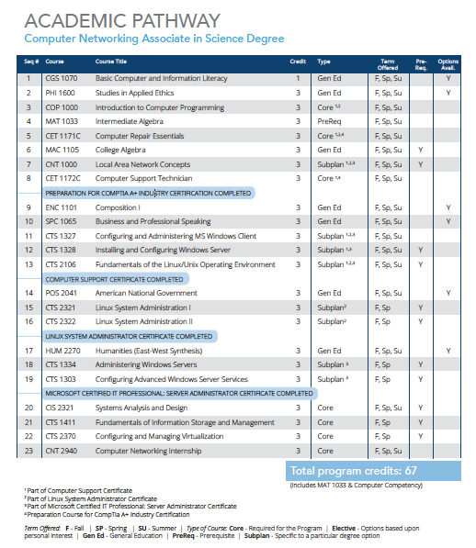
Academic Pathways
-6-

Slide 9
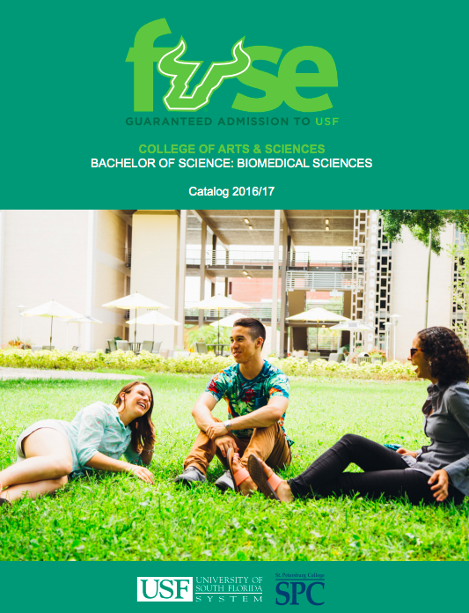
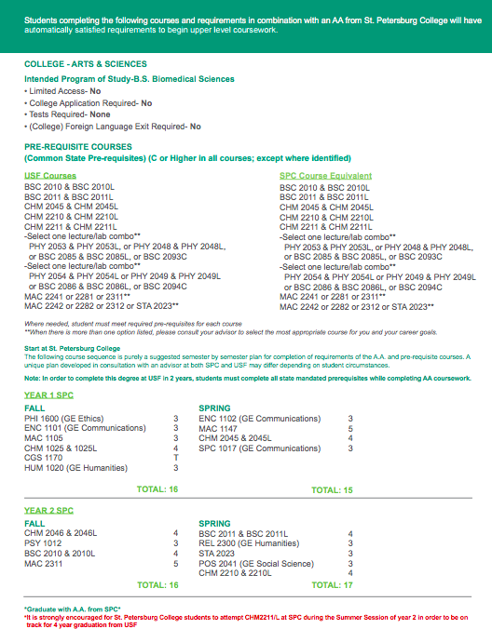
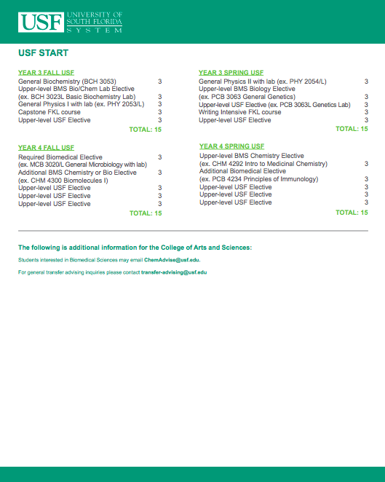

Slide 10
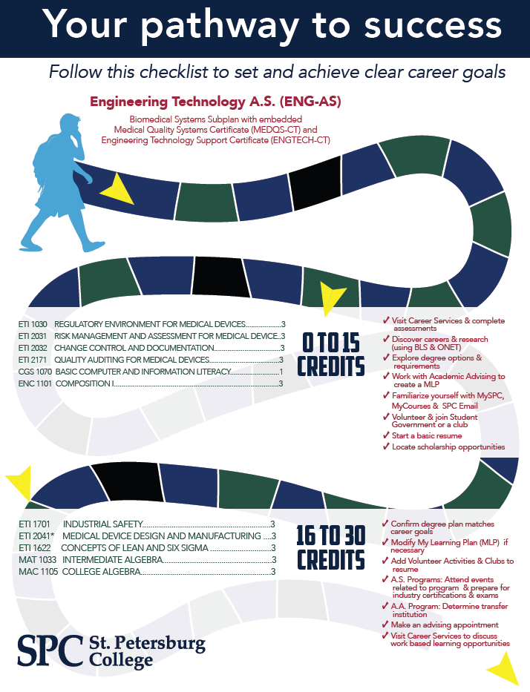
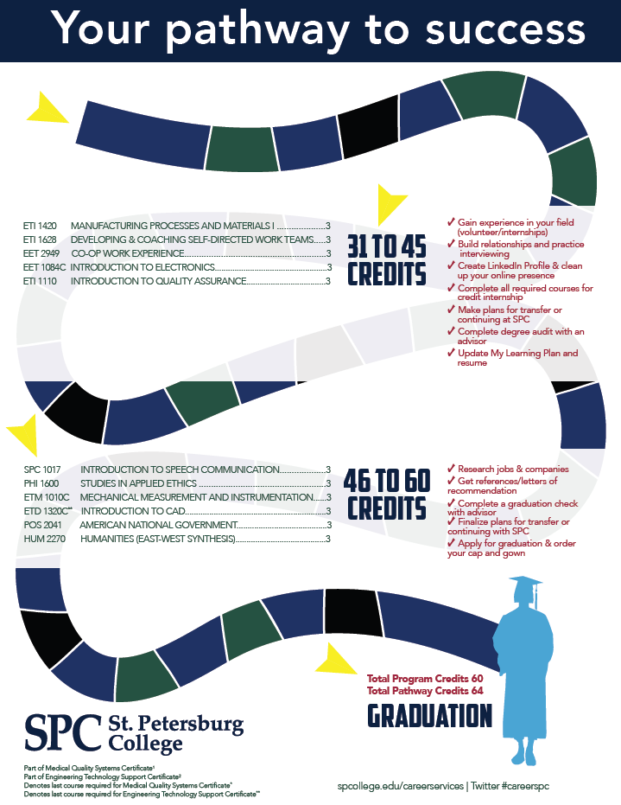
Show Students Their Path

Slide 11
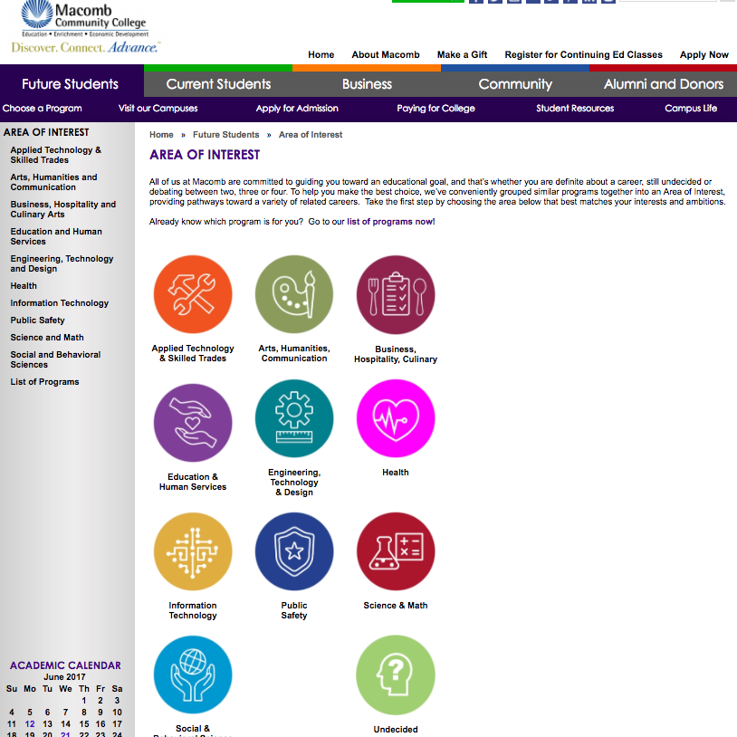
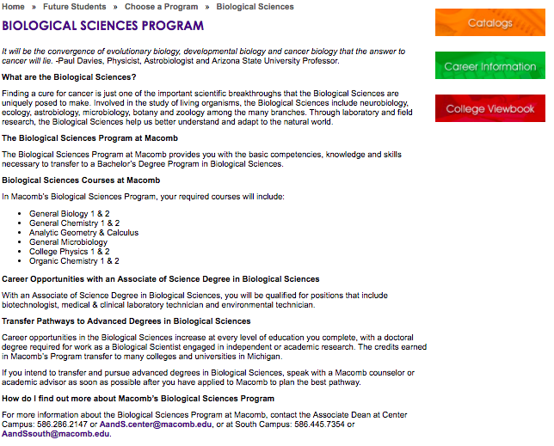
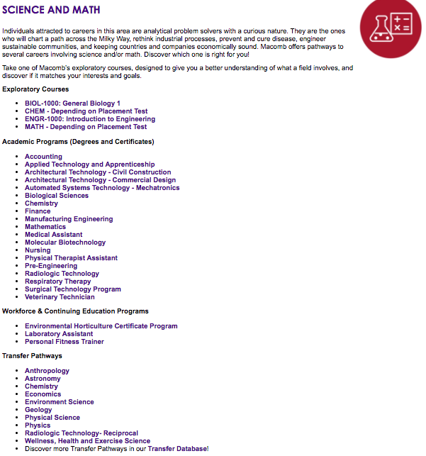

Slide 12
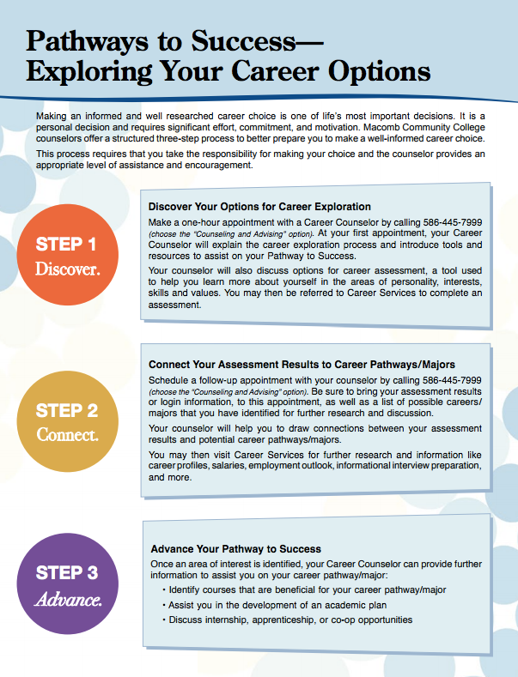
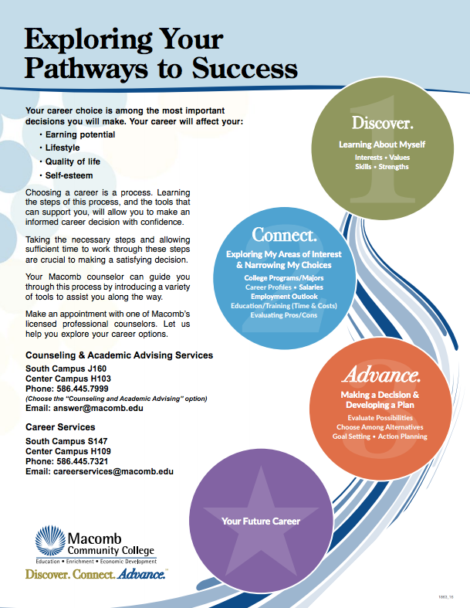

Slide 13
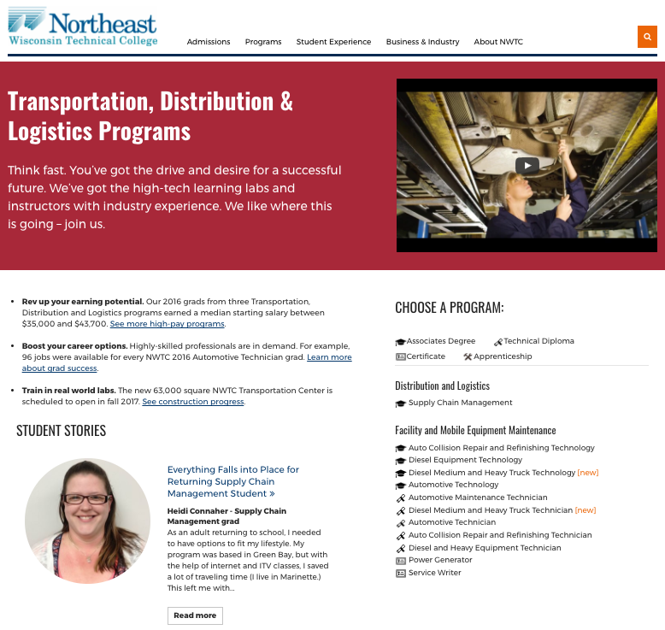
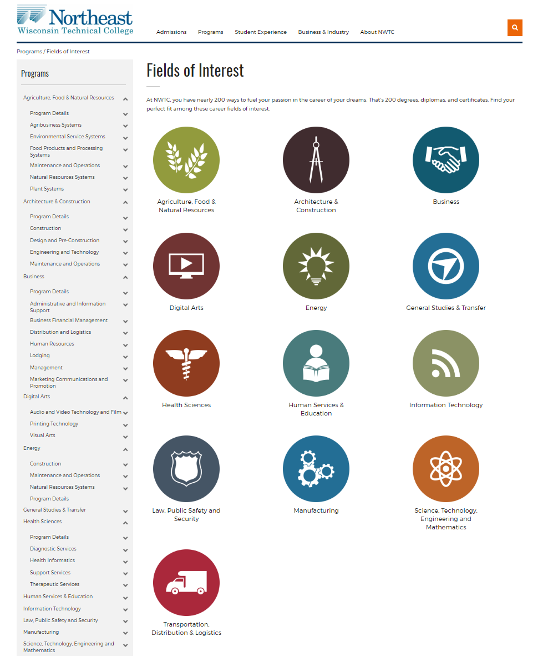
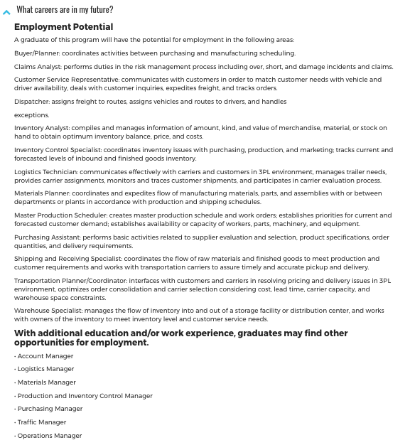
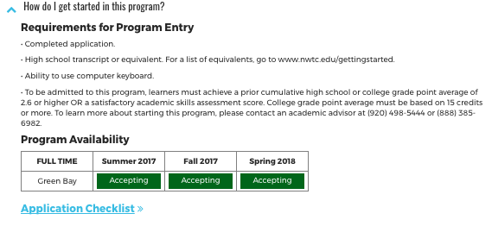
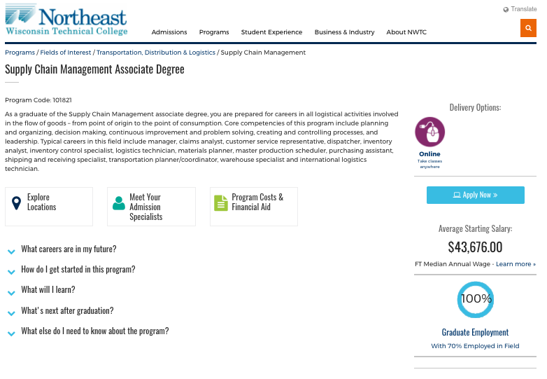
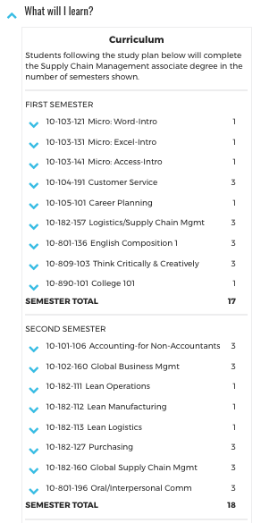
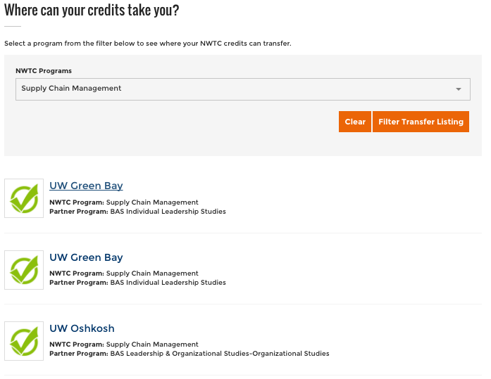
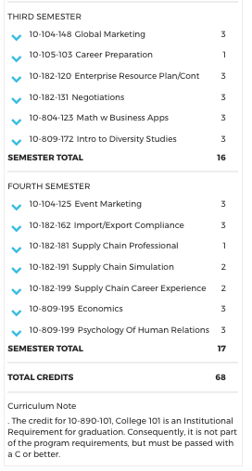
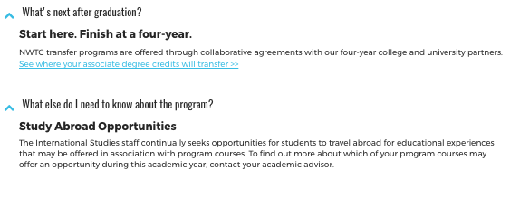

Slide 14
San Jacinto College: Math R&D Team
Source: San Jacinto College
Notes:
Examples:
- Lansing Community College (QR, statistics, or calculus)
- Alamo Colleges (Statistics, contemporary math, algebra)
- San Jacinto College (college algebra, statistics, quantitative reasoning, and finite math)
Next step is to add support courses

